Slide 1
Software Testing Techniques

Slide 2
Testing Objective
Primary Objective
  Testing is a process of executing a program with the intent of finding an error.
  A good test case is one that has a high probability of finding an as-yet undiscovered error.
  A successful test is one that uncovers an as-yet-undiscovered error
Objective is to design tests that systematically uncover different classes of errors and to do so with a minimum amount of time and effort.
Testing demonstrates that software functions appear to be working according to specification, that behavioral and performance requirements appear to have been met.
Data collected as testing is conducted provide a good indication of software reliability and some indication of software quality as a whole.
But testing cannot show the absence of errors and defects, it can show only that software errors and defects are present.

Slide 3
Testing Principles
All tests should be traceable to customer requirements
Tests should be planned long before testing begins
The *Pareto principle applies to software testing.
Testing should begin “in the small” and progress toward testing “in the large.”
Exhaustive testing is not possible
To be most effective, testing should be conducted by an independent third party
*for many events, roughly 80% of the effects come from 20% of the causes

Slide 4
Testability
Software testability is simply how easily a computer program can be tested.
Testing must exhibit set of characteristics that achieve the goal of finding errors with a minimum of effort.

Slide 5
Characteristics of s/w Testability
Operability: The better it works, the more efficiently it can be tested.
Observability: What you see is what you test.
Controllability: The better we can control the software, the more the testing can be automated and optimized."
Decomposability: By controlling the scope of testing, we can more quickly isolate problems and perform smarter retesting.

Slide 6
Simplicity: The less there is to test, the more quickly we can test it.
Stability: The fewer the changes, the fewer the disruptions to testing.
Understandability: The more information we have, the smarter we will test.

Slide 7
Testing attributes
A good test has a high probability of finding an error.
  Tester must understand the software and attempt to develop a mental picture of how the software might fail.
A good test is not redundant.
  Testing time and resources are limited.
  There is no point in conducting a test that has the same purpose as another test.
  Every test should have a different purpose
  Ex. Valid/ invalid password.
A good test should be “best of breed”
  In a group of tests that have a similar intent, time and resource limitations may mitigate toward the execution of only a subset of these tests.
A good test should be neither too simple nor too complex.
  sometimes possible to combine a series of tests into one test case, the possible side effects associated with this approach may mask errors.
  Each test should be executed separately

Slide 8
Test Case Design
Objectives of testing, we must design tests that have the highest likelihood of finding the most errors with a minimum amount of time and effort.
Test case design methods provide a mechanism that can help to ensure the completeness of tests and provide the highest likelihood for uncovering errors in software.
Any engineered product (and most other things) can be tested in one of two ways:
  Tests can be conducted that demonstrate each function is fully operational while at the same time searching for errors in each function;
  tests can be conducted to ensure that all internal operations are performed according to specifications and all internal components have been adequately exercised.
The first test approach is called black-box testing and the second, white-box testing.

Slide 9
Test cases and Test suites
Test case is a triplet [I, S, O] where
  I is input data
  S is state of system at which data will be input
  O is the expected output
Test suite is set of all test cases
Test cases are not randomly selected. Instead even they need to be designed.

Slide 10
Need for designing test cases
Almost every non-trivial system has an extremely large input data domain thereby making exhaustive testing impractical
If randomly selected then test case may loose significance since it may expose an already detected error by some other test case

Slide 11
Design of test cases
Number of test cases do not determine the effectiveness
To detect error in following code
    if(x>y) max = x; else max = y;
{(x=3, y=2); (x=2, y=3)} will suffice
{(x=3, y=2); (x=4, y=3); (x=5, y = 1)} will falter
Each test case should detect different errors

Slide 12
Test Data and Test Cases
Test data: Inputs which have been devised to test the system.
Test cases: Inputs to test the system and the predicted outputs from these inputs if the system operates according to its specification.

Slide 13
Test-to-pass and test-to-fail
Test-to-pass:
  assures that the software minimally works,
  does not push the capabilities of the software,
  applies simple and straightforward test cases,
  does not try to “break” the program.
Test-to-fail:
  designing and running test cases with the sole purpose of breaking the software.
  strategically chosen test cases to probe for common weaknesses in the software.

Slide 14
Black box testing
Also called behavioral testing, focuses on the functional requirements of the software.
It enables the software engineer to derive sets of input conditions that will fully exercise all functional requirements for a program.
Black-box testing is not an alternative to white-box techniques but it is complementary approach.
Black-box testing attempts to find errors in the following categories:
  Incorrect or missing functions,
  Interface errors,
  Errors in data structures or external data base access.
  Behavior or performance errors,
  Initialization and termination errors.

Slide 15
Black-box testing
Characteristics of Black-box testing:
  Program is treated as a black box.
  Implementation details do not matter.
  Requires an end-user perspective.
  Criteria are not precise.
  Test planning can begin early.

Slide 16
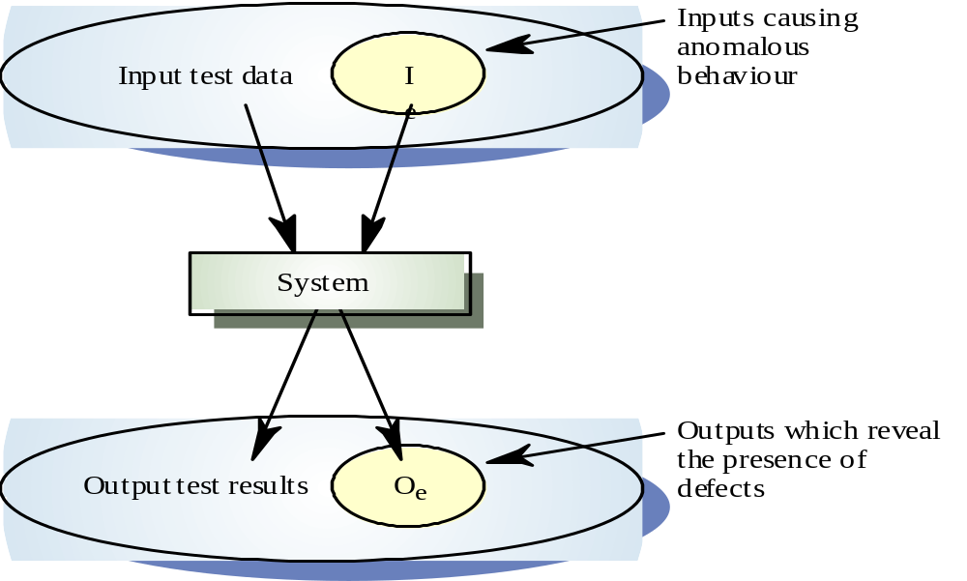
Black-box testing

Slide 17
Equivalence Partitioning
Equivalence partitioning is a black-box testing method that divides the input domain of a program into classes of data from which test cases can be derived.
Test case design for equivalence partitioning is based on an evaluation of equivalence classes for an input condition.
An equivalence class represents a set of valid or invalid states for input conditions.
Typically, an input condition is either a specific numeric value, a range of values, a set of related values, or a Boolean condition.

Slide 18
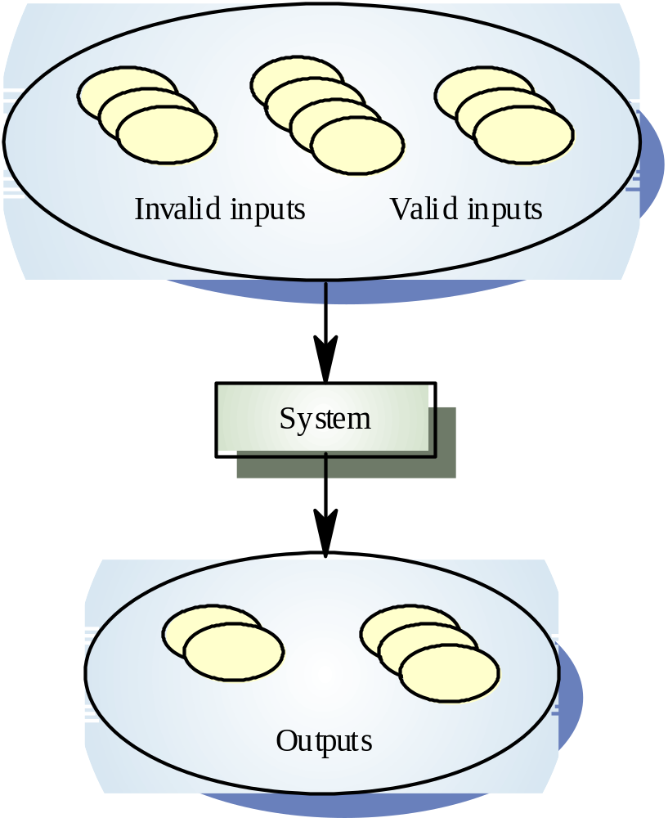
Equivalence
Partitioning
Equivalence partitioning is the process of methodically reducing the huge (or infinite) set of possible test cases into a small, but equally effective, set of test cases.

Slide 19
To define equivalence classes follow the guideline
If an input condition specifies a range, one valid and two invalid equivalence classes are defined.
If an input condition requires a specific value, one valid and two invalid equivalence classes are defined.
If an input condition specifies a member of a set, one valid and one invalid equivalence class are defined.
If an input condition is Boolean, one valid and one invalid class are defined.

Slide 20
Formation of EC
  One valid EC and two invalid EC
  Input is 0<n<max
  Valid EC is (0-max)
  Invalid EC1 : all n < 0
  Invalid EC2 : all n > max

Slide 21
Boundary Value Analysis (BVA)
Boundary value analysis is a test case design technique that complements equivalence partitioning.
Rather than selecting any element of an equivalence class, BVA leads to the selection of test cases at the "edges" of the class.
In other word, Rather than focusing solely on input conditions, BVA derives test cases from the output domain as well.

Slide 22
Guidelines for BVA
If an input condition specifies a range bounded by values a and b, test cases should be designed with values a and b and just above and just below a and b.
If an input condition specifies a number of values, test cases should be developed that exercise the minimum and maximum numbers. Values just above and below minimum and maximum are also tested.
Apply guidelines 1 and 2 to output conditions.
If internal program data structures have prescribed boundaries be certain to design a test case to exercise the data structure at its boundary

Slide 23
Boundary Value Analysis
Some typical programming errors occur:
  at boundaries of equivalence classes
  might be purely due to psychological factors.
Programmers often fail to see:
  special processing required at the boundaries of equivalence classes.

Slide 24
Boundary Value Analysis
Programmers may improperly use < instead of <=
Boundary value analysis:
  select test cases at the boundaries of different equivalence classes.

